Slide 1

Enterprise Project Management at Microsoft
Published:
August 2005
Notes:
Abstract
CUSTOMER READY: This 16-slide presentation, based on a nine-page technical case study published in August 2005, provides an overview of how Microsoft Information Technology (Microsoft IT) uses the Microsoft® Office Enterprise Project Management (EPM) solution to provide a central project management repository that enables integration with other line-of-business and consolidated reporting systems.
Introduction
The Microsoft Original Equipment Manufacturer (OEM) IT Development group develops, maintains, and supports OEM business solutions. The OEM IT group required an enterprise project management system that would enable project managers to efficiently allocate and level globally dispersed resources to their individual project plans. Additionally, the OEM IT group required a more integrated project portfolio reporting system that would enable their clients and stakeholders to see project portfolio health and global resource availability.
The solution that the OEM IT group implemented may help other enterprise organizations move from a loosely coupled project management system to a true enterprise project management solution. This presentation is intended for chief information officers, project managers, project portfolio managers, and technical decision makers who have a need for an enterprise project management solution.

Slide 2

Solution Overview
Situation
OEM IT Development group needed to report its project portfolio accurately to other groups
Solution
Microsoft Office Enterprise Project Management
Benefits
Maximize resource utilization
Collaborate and share project plan data
Integrate with other line-of-business systems
Eliminate manual process to save 100 hours a month
Notes:
Solution Overview
Situation
The Microsoft OEM IT Development group's existing process did not efficiently facilitate the consolidation and forecasting of the entire project portfolio for review by other groups and stakeholders.
Solution
The Microsoft Office Enterprise Project Management solution delivered the features and benefits that provided the OEM IT group with the resource management tools and automated processes to effectively manage resources and report the entire project portfolio accurately.
Benefits
Maximize resource utilization across the entire project portfolio.
Collaborate and share project plan data from a central repository.
Facilitate the integration with other line-of-business systems in the organization.
Eliminate manual resource allocation and consolidation processes. This saves over 100 hours each month.

Slide 3




Products and Technologies
Microsoft Office Project Professional 2003
Office Professional 2003
Microsoft Project Server 2003 with Microsoft Project Web Access
Windows Server 2003
Internet Information Services 6.0
Windows SharePoint Services
Notes:
Products and Technologies
Microsoft Office Project Professional 2003
Microsoft Office Professional 2003
Microsoft Project Server 2003 with Microsoft Project Web Access
Microsoft Windows Server™ 2003
Microsoft Internet Information Services 6.0
Microsoft Windows® SharePoint® Services

Slide 4

Situation
Project management process for the resource pool was inefficient
OEM IT group needed:
  A reliable business solution
  A central repository
  An enterprise resource pool
  An automated solution
  A reporting solution
Notes:
Situation
The Microsoft OEM IT Development group manages between 40 and 50 development projects annually. The OEM IT group is made up of up to 250 resources that are globally dispersed in Redmond, Washington; Reno, Nevada; Dublin, Ireland; and Hyderabad, India. Additionally, the resources are either full-time equivalents (FTEs) or outsourced resources that are sourced through vendor partnerships.
The project management process that was set up to share, allocate, level, and cost the resource pool to individual projects was not efficient, and it was inconsistently applied. Additionally, the monthly consolidation of the individual project plans into a complete project portfolio was labor-intensive and sometimes prone to inaccuracies.
The project managers in the OEM IT group used Microsoft Project 2000 and Microsoft Office Excel® 2003 to individually manage their projects. The effort that was required to correctly allocate and level resources across the OEM IT group project portfolio was very difficult and time-consuming. The manual process required project managers to meet regularly to resolve resource problems and to manually change or replace resources frequently for their individual project plan tasks. Compound the manual processes with the fact that the resources were located globally around the world and were sourced both from internal and external sources—the result that was required for effective resource utilization was frequently unattainable.
To report the health of the OEM IT group project portfolio to senior management and other groups within Microsoft, project managers manually extracted forecast data from their individual project plans. Additionally, they transposed the data into a consolidated Excel worksheet. Before they extracted the project plan data, the project plan was manually verified to make sure that the resource allocation, leveling, and costing were correct. Once this information was verified, the forecast worksheet was consolidated with a project budget worksheet and an actual expenditures worksheet to produce a project portfolio tracking worksheet. This process was not only labor-intensive, but it was subject to errors.
This process did not always produce an accurate forecast result. This was especially true when project plans were incorrectly resourced or when the project plan data was not updated in the forecast worksheet. To improve the manual process and to effectively report the OEM IT group project portfolio health to clients, stakeholders, and senior management, the following functional requirements were needed:
A reliable business solution—Microsoft Office Project Professional 2003 was used to task, resource, and drive OEM business solution projects for clients.
A central repository—A central repository was required to enable effective collaboration and to share project plan data.
An enterprise resource pool—An enterprise resource pool that displayed resource availability across the OEM IT project portfolio and the ability to manage resource allocation and leveling by using a more automated process.
An automated solution—An automated solution that enabled the integration of project plan data with other line-of-business systems both inside and outside the OEM IT group.
A reporting solution—A reporting solution that reported the consolidated project portfolio health and enabled users to slice and dice project data to meet their reporting requirements.

Slide 5
Solution
Presentation tier
  Microsoft Project Professional 2003 and Internet Explorer
Application tier
  Microsoft Project Server 2003, Microsoft Project Web Access, Windows SharePoint Services
Database tier
  SQL Server 2000 and SQL Server 2000 Analysis Services
Notes:
Solution
The Microsoft Office EPM solution was deployed to enable the OEM IT group to effectively manage global resources, collaborate across groups, and report the project portfolio health. The general logical architecture of the Microsoft Office EPM solution can be broken down into the following three tiers.
Note: The physical architecture of a Microsoft Office EPM solution can vary depending on the scale of the deployment and existing physical constraints.
Presentation Tier
The presentation tier uses Microsoft Project Professional 2003 and Microsoft Internet Explorer as client applications that access the project server. With Microsoft Project Professional, collaboration features, project plans, global resources, and global templates can be accessed from Microsoft Office Project Server 2003. When you use Internet Explorer, Microsoft Project Web Access provides configurable views. It also provides reports on complete project portfolio and resource availability.
Application Tier
The application tier is made up of Microsoft Project Server 2003, Microsoft Project Web Access, and Windows SharePoint Services. When Project Server is installed, the setup program integrates the Microsoft Project Web Access components and Web parts into a Windows SharePoint Services Web site. Servers that are running Windows SharePoint Services provide a global access point so that users can view and collaborate on all project-related data.
Database Tier
The database tier is made up of Microsoft SQL Server™ 2000 and Microsoft SQL Server 2000 Analysis Services. SQL Server 2000 provides the repository for the Microsoft Project Server database. SQL Server 2000 Analysis Services provides data warehousing services for the various pivot tables and charts that can be accessed from both Microsoft Project Professional and Microsoft Project Web Access.

Slide 6
Solution
Central repository of project plans
  Plans published in Microsoft Project Server database
Global enterprise templates
  SDLC process used in all development projects
  Templates rely on custom fields, formulas, and generic resources
Notes:
Solution (continued)
The Microsoft Office EPM solution let the OEM IT group take advantage of the following features provided in the product:
Central repository of project plans
Global enterprise templates
Global resource pool
Project Web Access views
User and role-based security model
Consolidated reporting
Line-of-business integration functionality
Central Repository of Project Plans
All Microsoft Project Professional plans are now centrally located in the Microsoft Project Server database, and they are updated as required. This functionality enables the group and the group's stakeholders to have a consistent and accurate view of the complete OEM IT group project portfolio. Instead of saving the project plans on a network share, project managers now publish their plans to the Microsoft Project Server database by using the collaboration features that are included in Microsoft Project Professional 2003.
Note: During the implementation phase, project plans were updated to Microsoft Project Professional 2003. Then, they were imported into the Microsoft Project Server database, and the group created a global enterprise template from the individual imported project plans.
Global Enterprise Templates
The OEM IT development group uses the Microsoft IT Software Development Life Cycle (SDLC) process in all development projects. Global enterprise templates enabled the group to incorporate this process in a global template. By implementing each stage of the SDLC process into the new global enterprise template, each project plan that was created from the enterprise global template had SDLC stages implemented as tasks or as milestones.
When they designed the enterprise global template, the OEM IT group used the following Microsoft Project Server features to help provide a standardized template to enable project managers to task and resource new projects quickly:
Custom fields—Custom fields were used in several areas. For example, to enable integration with other enterprise systems, a custom field was set up to record the enterprise project code.
Formulas—Formulas enhanced the custom reporting abilities in both Microsoft Project Professional and Microsoft Project Web Access.
Generic resources—Each task in the global enterprise template had a generic resource applied.

Slide 7
Solution
Global resource pool
  Pool created from imported project plans
  Project managers identify resources by using custom codes, detailed skill sets, generic resources, and new resources
  Project managers able to use “replace” functionality to build project plans
Notes:
Solution (continued)
Global Resource Pool
The ability to effectively manage a global resource pool is one of the main features of Microsoft Project Server 2003. In the implementation stage of deploying Microsoft Project Server, when the OEM IT group imported the project plans, they also imported the project resources to create a global resource pool. The OEM IT group then fine-tuned the enterprise resource pool, and they removed any duplicates.
The OEM IT group applied the following Microsoft Project Server features to enable project managers to quickly identify the correct resource for their project tasks:
Custom codes—Custom codes were used to determine whether the resource was an FTE or a contingent resource.
Detailed skill sets—Detailed skill sets were applied to each resource.
Generic resources—Generic resources were set up, and each generic resource had a skill set and cost applied to it.
New resources—New resources were created by selecting the user account from the Active Directory® directory service.
Note: The OEM IT group quickly learned that a central enterprise resource pool administration function was required to make sure that there was standardization in the setup and maintenance processes of the resource pool.
With the global resource pool in place, project managers now were able to use the "replace" functionality in Microsoft Project Professional to quickly build their new project plans from the enterprise global template. These new project plans had generic resources applied to each task. When they used the global resource pool, project managers are able to filter results by skill set, location, and availability so that they could correctly assign the resource to the specific task. Additionally, when a resource became unavailable or replaced, this functionality let the project manager quickly replace and update their project plan with an appropriate secondary resource.

Slide 8
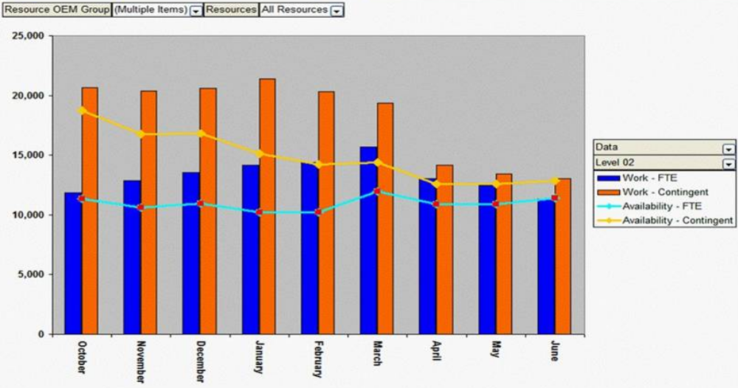
Solution
Notes:
Solution (continued)
Project Web Access Views
The Microsoft Project Web Access Web site for the Microsoft Office EPM solution provides unique capabilities that work with Microsoft Project Server to display project data. Microsoft Project Web Access provides the following four views to the OEM IT group project portfolio data:
Project Center—Project Center lists all the projects that make up the OEM IT group project portfolio.
Resource Center—Resource Center lists the global resource pool and availability.
Portfolio Analyzer—Portfolio Analyzer is used to analyze project portfolio data by using both pivot tables and charts.
Portfolio Modeler—Portfolio Modeler is used to perform "what if" project portfolio scenarios.
The OEM IT group customized some of the basic views for their specific reporting needs. For example, in the figure on this slide, the OEM IT group used a chart in Portfolio Analyzer to help discuss development project priorities with senior management.
This chart shows the work that was required for project completion against the work that was available for the entire OEM IT group. The chart uses a custom code that was implemented in the global enterprise template. This custom code breaks the global resource pool into FTE work and into contingent vendor work. This chart helped the OEM IT group balance internal resources with external resources across various projects.
Other customized views that helped the OEM IT group manage the global resource pool and report the project portfolio health included the following:
Total work for all resources chart.
Total work against availability for all resources chart.
Work versus availability at 80 percent and 100 percent availability chart.
Work versus availability by individual OEM IT group (development, test, etc.) pivot table.
Over and under allocation by resources at 80 percent and 100 percent availability pivot table.
Work cost by business category pivot table.
Note: This small sample of charts and pivot tables is available in the related views in Microsoft Project Web Access.
Armed with the various Microsoft Project Web Access views, the OEM IT group can graphically display project statuses and resource constraints to senior management in real time.

Slide 9
Solution
User and role-based security
  Limiting access to project plan data at specific levels
Consolidated reporting
  Graphically displaying key business metrics and providing a complete view of the project portfolio
Notes:
Solution (continued)
User and Role-Based Security
When deploying Microsoft Project Server, the OEM IT group implemented the role-based security model that is included in Microsoft Project Server. This enabled the OEM IT group to limit access to project plan data at very specific levels. For example, vendor partnerships were regularly sourced for either whole projects or for specific tasks within internal projects. The Microsoft Project Server security model enabled the OEM IT group to limit external resources so that they could only view the project data that they were actively working on.
Consolidated Reporting
With Microsoft Project Web Access, the OEM IT group can report the consolidated results of the project portfolio in real time. By using the numerous customized views in Project Center, Project Portfolio, and Resource Center, the OEM IT group can graphically display key business metrics and provide a complete view of the project portfolio.

Slide 10
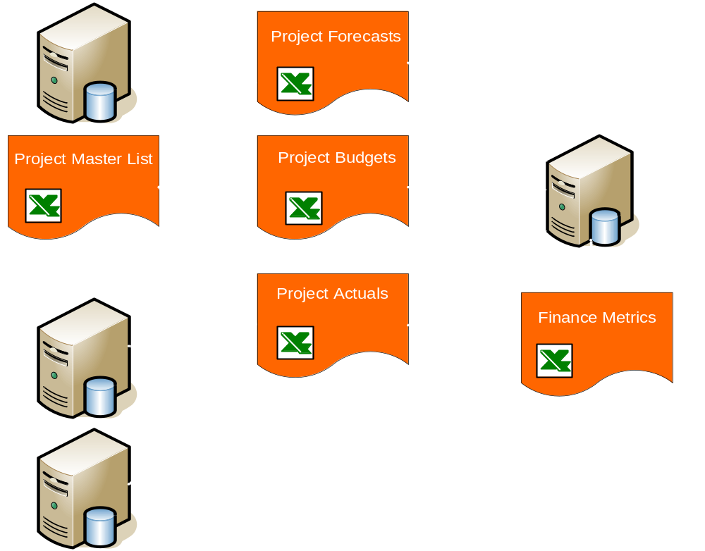
Solution
Notes:
Solution (continued)
Line-of-Business Integration
Integration with other systems in Microsoft is now completed by using Microsoft Office automation and SQL Server 2000 Data Transformation Services (DTS). For example, the monthly process that the OEM IT group had to perform to consolidated project plan forecasts with actual data and budget data has been redesigned to pull project forecast data directly from Microsoft Project Server databases. Before the deployment of Microsoft Project Server, the consolidation of the project forecast data was a manual process. The figure on this slide is a process diagram of the automated process that now occurs monthly to report the consolidated results.
By using the Microsoft Office EPM solution, project forecast data is pulled directly from the Microsoft Project Server database by using Microsoft Office automation. Then, the resulting forecast is transferred into the SQL Server 2000 consolidated databases by using DTS. After the transfer, the consolidated database is updated with the project budget and actual expenditures by using a similar process. The resulting consolidated database is presented to stakeholders and senior management in a consolidated pivot table embedded in a Finance Metrics Excel spreadsheet.
By using the Microsoft Project Server database directly, the OEM IT group eliminated the requirement to manually update the forecast spreadsheet with their individual project plan data.

Slide 11
Best Practices
Phased implementation
  Gradual adoption of new enterprise project management processes
Least privilege access
  Microsoft Project Server security roles established security settings for custom views
Notes:
Best Practices
Some of the best practices that the OEM IT group embraced when they deployed the Microsoft Office EPM solution included the following:
Phased implementation—When deploying the Microsoft Office EPM solution, the OEM IT group used a phased approach. By phasing in the global resource pool, global enterprise template, and custom views, project managers were able to gradually adopt the new enterprise project management processes. The OEM IT group is reviewing other features that are available in Microsoft Project Server. Each Microsoft Project Server feature will be evaluated and phased in when appropriate.
Least privilege access—By using the security features available in Microsoft Project Server and Microsoft Project Web Access, the OEM IT group was able to define a security model that provided least privilege access to the groups and users of the solution. When designing the various custom views in Microsoft Project Web Access, the security setting used to access each view was implemented using the Microsoft Project Server security roles.

Slide 12
Benefits
Global resource management
Collaboration and sharing
Line-of-business integration
Accurate and timely project portfolio status
Time savings—100 hours a month
Notes:
Benefits
By implementing the Microsoft Office EPM solution, the OEM IT group achieved significant benefits and time savings. The following is a list of the key benefits that the OEM IT group acquired:
Global resource management—Through the use and the continued maintenance of the global enterprise pool, resource utilization across the entire project portfolio was maximized. By supplying a framework that provided the tools to view, allocate, and level resources across the OEM IT group project portfolio, project managers accurately forecasted and met enterprise project objectives.
Collaboration and sharing—Microsoft Project Web Access provided a secure global view of the complete OEM IT group project portfolio. Clients, stakeholders, and senior management had access to one true view that represented the health of the OEM IT group project portfolio.
Line-of-business integration—Moving and storing project plan data into a central repository enabled the integration of project data with other line-of-business systems.
Accurate and timely project portfolio status—The OEM IT group approached senior management with the confidence that their project forecasts were accurate and up-to-date. Additionally, better decisions on future project proposals were made considering the detailed reporting of the enterprise resource pool.
Time savings—By using Microsoft Project Server features, the time saved in manually performing resource allocation, leveling, and consolidating project results has been estimated to be over 100 hours each month.

Slide 13

Conclusion
OEM IT group can use the enterprise resource pool efficiently
Manual resource allocation and leveling processes were eliminated
Integration and reporting of Microsoft Project Server data with other line-of-business systems were automated
Resource requirement forecasts are accurate
Notes:
Conclusion
With the deployment of the Microsoft Office EPM solution, the OEM IT group can use the enterprise resource pool efficiently. The manual resource allocation and leveling processes were eliminated, which saves more than 100 hours each month. The integration and the reporting of Microsoft Project Server data with other line-of-business systems were automated, and the OEM IT group can present their project portfolio forecasts with the confidence that their resource requirements are accurate.

Slide 14
For More Information
Project Server Deployment Resources: http://office.microsoft.com/en-us/FX011442351033.aspx
Enterprise Project Management (EPM) Solution Overview: http://www.microsoft.com/office/project/prodinfo/epm/overview.mspx
Notes:
For More Information
For more information about deploying Microsoft Project Server, refer to the Project Server Deployment Resources page at http://office.microsoft.com/en-us/FX011442351033.aspx.
For an overview of the Microsoft Enterprise Project Management solution, refer to the Enterprise Project Management (EPM) Solution Overview at http://www.microsoft.com/office/project/prodinfo/epm/overview.mspx.

Slide 15

For More Information
Additional content on Microsoft IT deployments and best practices can be found on http://www.microsoft.com
  Microsoft TechNet http://www.microsoft.com/technet/itshowcase
  Microsoft Case Study Resources
  http://www.microsoft.com/resources/casestudies
Notes:
For More Information (continued)
Additional content on Microsoft IT deployments and best practices can be found on
http://www.microsoft.com.
TechNet:
http://www.microsoft.com/technet/itshowcase
Case Study Resources:
http://www.microsoft.com/resources/casestudies
About Microsoft IT Showcase
Microsoft IT Showcase is a collection of key business applications, deployment strategies, early adopter experiences, best practices, and leading-edge initiatives direct from the Microsoft IT organization.
IT Showcase features case studies, white papers, presentations and multimedia presentations that illustrate internal business applications, product deployment experiences, and other key IT initiatives being implemented within Microsoft.
Microsoft IT's Experience
Early adopter: Microsoft IT is often the first to implement new Microsoft products in a production environment—and to develop line-of-business applications based on Microsoft technologies. Knowing what challenges we've faced and how we dealt with them can help you as you plan and execute similar projects.
Large-scale deployments: Microsoft IT oversees worldwide deployments, both of Microsoft’s products and those of other vendors. The issues we have to deal with and the lessons we learn along the way can help you as you gear up for your own large rollouts.

Slide 16


This document is provided for informational purposes only.
MICROSOFT MAKES NO WARRANTIES, EXPRESS OR IMPLIED, IN THIS DOCUMENT.
© 2005 Microsoft Corporation. All rights reserved.
This presentation is for informational purposes only. MICROSOFT MAKES NO WARRANTIES, EXPRESS OR IMPLIED, IN THIS SUMMARY. Microsoft, Active Directory, Excel, SharePoint, Windows, and Windows Server are either registered trademarks or trademarks of Microsoft Corporation in the United States and/or other countries. The names of actual companies and products mentioned herein may be the trademarks of their respective owners.
Notes:
© 2005 Microsoft Corporation. All rights reserved.
This presentation is for informational purposes only. MICROSOFT MAKES NO WARRANTIES, EXPRESS OR IMPLIED, IN THIS SUMMARY. Microsoft, Active Directory, Excel, SharePoint, Windows, and Windows Server are either registered trademarks or trademarks of Microsoft Corporation in the United States and/or other countries. The names of actual companies and products mentioned herein may be the trademarks of their respective owners.

